Slide 1
Landing Page
Mobile

Slide 2
HEADER
Book now
LOGO AND NAME OF THEMEPARK
Menu
Opening hours information
Purchase button
Drop down menu
Ad about how this park is amazing with a nice picture of a family having fun!!!!!
Carousel Pictures with changing images at set interval
Shrink down caousel
Click for previous carousel item
Click for next carousel item
BODY
Activity 1
Activity 2
Activity 3
Activity 4
Swiping left or right will be able to explore other activities indicated by the black dot

Slide 3
Food option 1
Food option 2
Food option 3

Slide 4
Hotels Nearby
Information about rides
Transportation (car, bus, train)

Slide 5
5 Star review from fake customer…

Slide 6
Mascot photo 1
Mascot 1 information
Mascot 2 information
Mascot photo 2
Mascot photo 3
Mascot 3 information

Slide 7



Random photo from official instagram
Random photo from official instagram
Random photo from official instagram
Random photo from official instagram
Swiping left or right will be able to explore other activities indicated by the black dot
Newsletter
Enter your email for the latest update and promotions
Submit button
Awards to show off
FOOTER
Term of Service
Official Partners
Copyright Information
About Us

Slide 8
Random photo from official instagram
Random photo from official instagram
Random photo from official instagram
Random photo from official instagram
Swiping left or right will be able to explore other activities indicated by the black dot
Newsletter
Enter your email for the latest update and promotions
Submit button
Awards to show off
FOOTER
Term of Service
Official Partners
Copyright Information
About Us

Slide 9
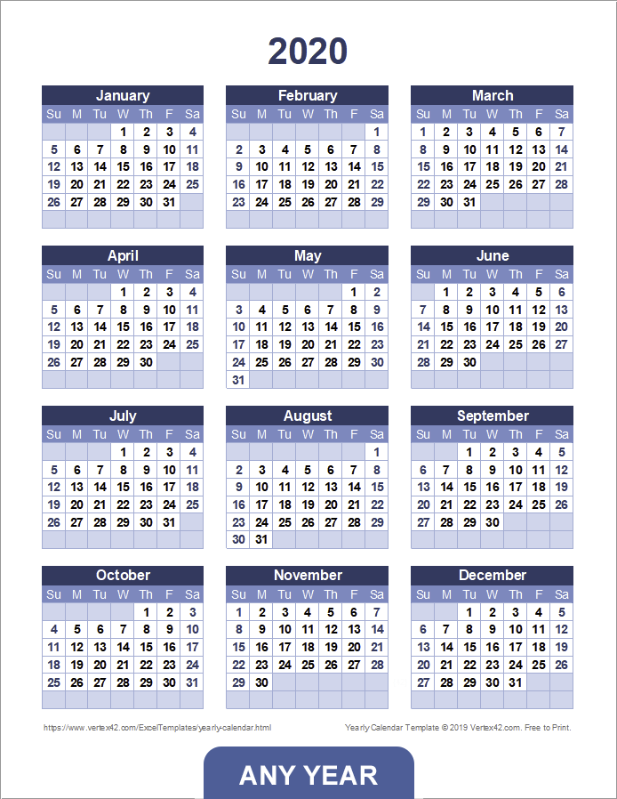
HEADER
View Cart
LOGO AND NAME OF THEMEPARK
Menu
Opening hours information
View Cart button
Drop down menu
Touching the arrow button will change the year
Touching the date will select it
Next
Term of Service
Copyright Information
Official Partners
About Us

Slide 10
HEADER
View Cart
LOGO AND NAME OF THEMEPARK
Menu
Opening hours information
View Cart button
Drop down menu
Date selected will be displayed here
Boxes to choose How many people
Prices
Adults x $39.99
Children x $19.99
Enter voucher code
Total cost with breakdown
Next
Term of Service
Copyright Information
Official Partners
About Us

Slide 11

HEADER
View Cart
LOGO AND NAME OF THEMEPARK
Menu
Opening hours information
View Cart button
Drop down menu
Date selected will be displayed here
Breakdown information will be displayed here
Eg:
Adult: 3 x 39.99 = 119.97
Kids: 2 x 19.99 = 39.98
Total = 159.95
Card Holder Name
Card Number
Expiry Date MM/YY
CCV
Pay Now
Term of Service
Copyright Information
Official Partners
About Us

Slide 12
FAQ´S

Slide 13
HEADER
Book now
LOGO AND NAME OF THEMEPARK
Menu
Opening hours information
Purchase button
FAQ information
Drop down menu

Slide 14
For other questions not covered in FAQ
Name:
Text box
Email:
Text box
Your question:
Text box
Submit button
FOOTER
Term of Service
Official Partners
Copyright Information
About Us

